Slide 1
ONLINE SHOPPING
TEAM NO:09

Slide 2

PROJECT LEAD:
MATTE SOUMYA REDDY -10683745
MEMBERS:
VARAD NILESH SURYAWANSHI -10683807 ASHWIN D -10683416 KIRTI BARAPATRE - 10683642
TEAM SKART
(SHOPPING CART)

Slide 3
OBJECTIVE:
To design and create an easy yet powerful web based online shopping platform.
To create an Angular based Web Application that enables the user to go through the platform smoothly.
To create a strong and secured database connectivity using ASP .NET Core and SQL Server Technology.

Slide 4
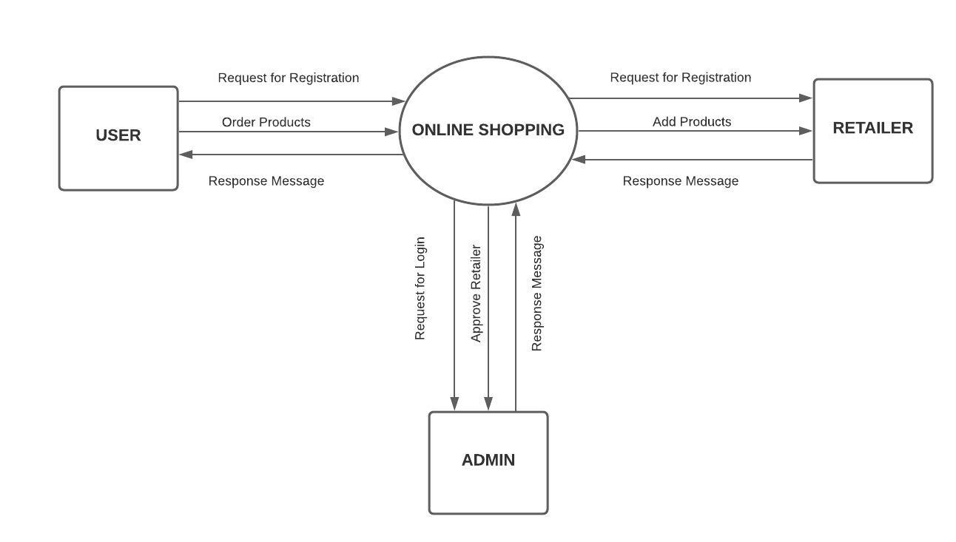
PROJECT FLOW:

Slide 5
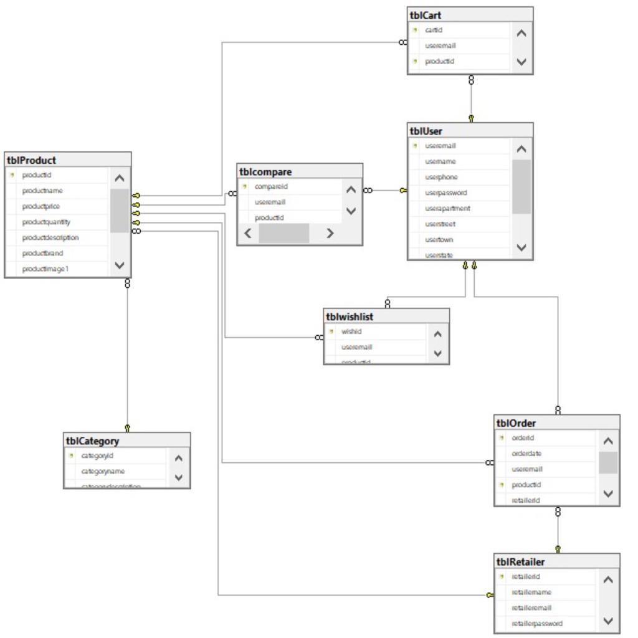
DATABASE SCHEMA:

Slide 6
User Module:
User
Register
New User
Login for
existing
User
Change
Password
Search
for Products
Add
Products
to cart
View
Product
Details
Order
Products

Slide 7
Retailer Module:
Retailer
Register
New Retailer
Login for
existing
Retailer
Change
Password
Add
Product
Details
View
Product
Details

Slide 8
Admin Module:
Admin
Approve Retailer

Slide 9
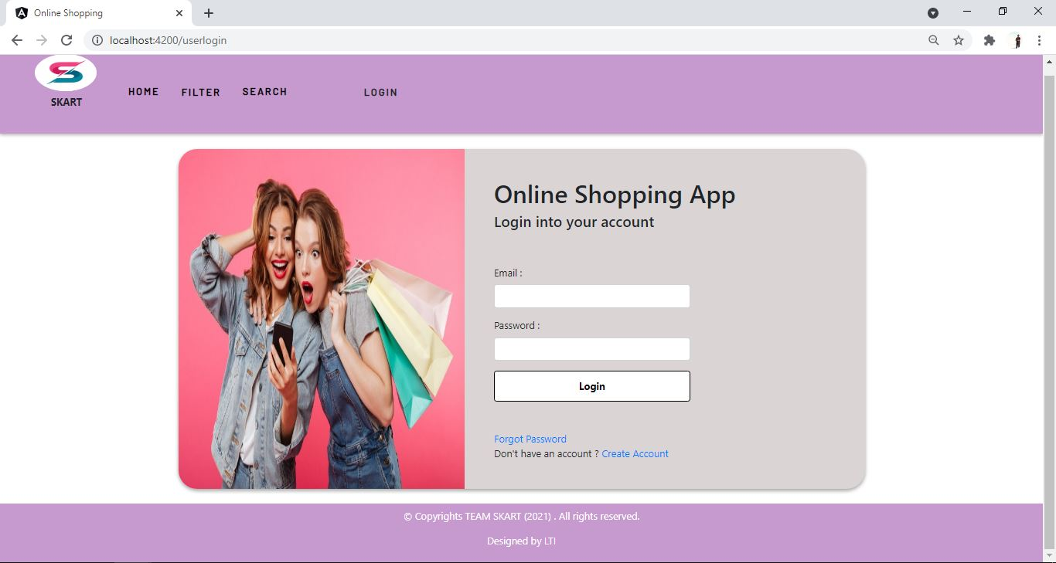
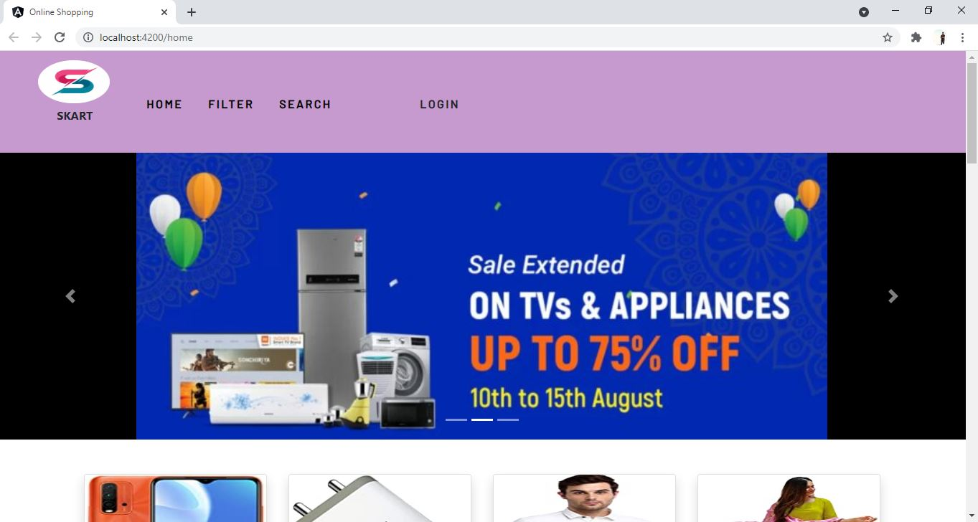
SCREENSHOTS:

Slide 10
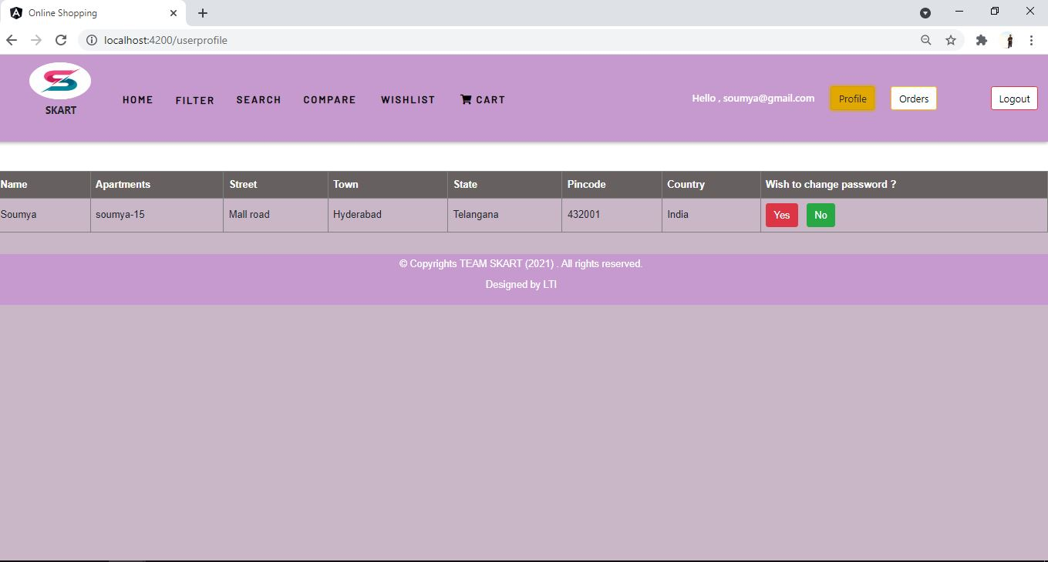
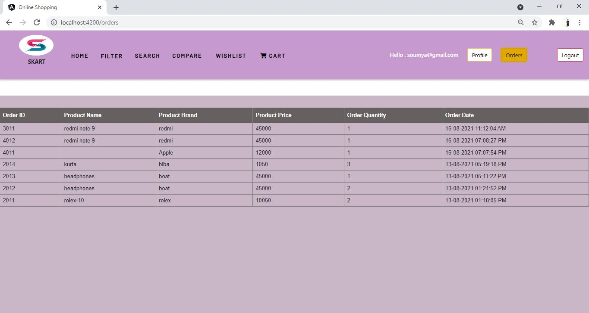
SCREENSHOTS:

Slide 11
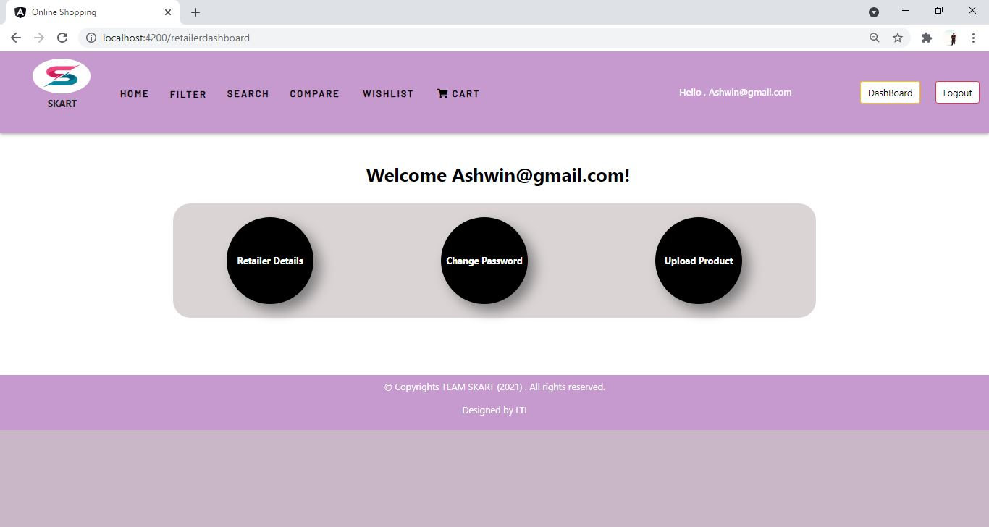
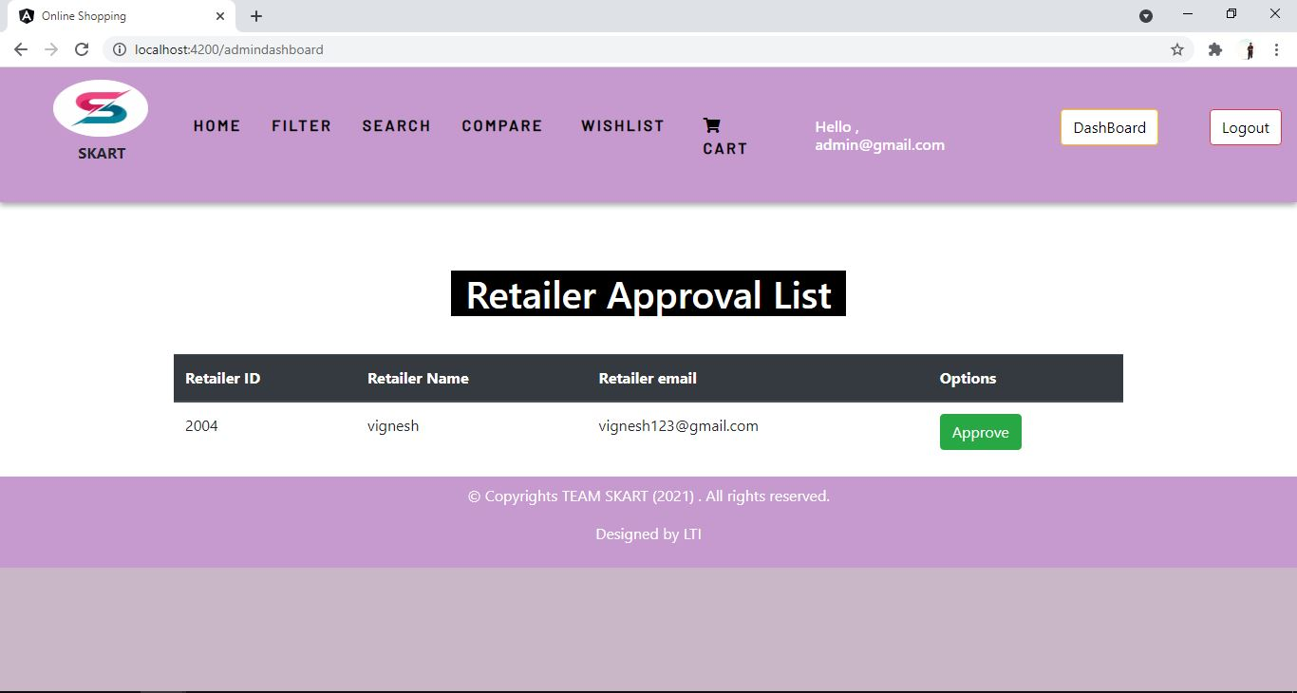
SCREENSHOTS:

Slide 12
PROJECT DEMO !!!

Slide 13
THANK YOU !!!

